Slide 1

ANOVA
Research Methods 1

Slide 2
Quasi-Experimental Designs
In non-experimental designs, little or no attempt to address threats to internal validity
In experimental designs, maximum attempt to address threats to internal validity
In quasi-experimental designs, there are attempts to minimize threats to internal validity, but because of the variables under consideration, full control and manipulation (e.g. random assignment) is impossible

Slide 3
Quasi-Experimental Designs
Situations that require quasi-experimental design arise when you want to study things like:
Effects of participant variables (e.g. age, gender, ethnicity, infant attachment style) on some DV
Variables that cannot be manipulated practically (e.g. choice of major, vocabulary size)
Variables that cannot be manipulated ethically (e.g. parenting style, age of exposure to language)
More internal validity than non-experimental designs, but possible confounds an issue

Slide 4
What if you want to study multiple IVs? Or an IV with more than 2 levels?

Slide 5
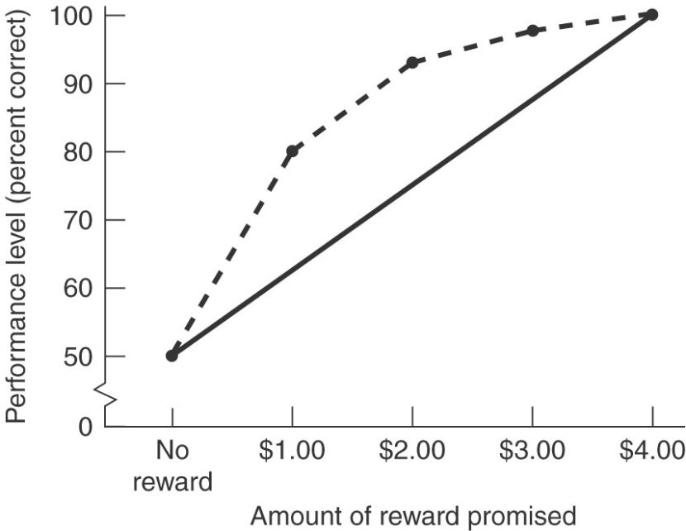
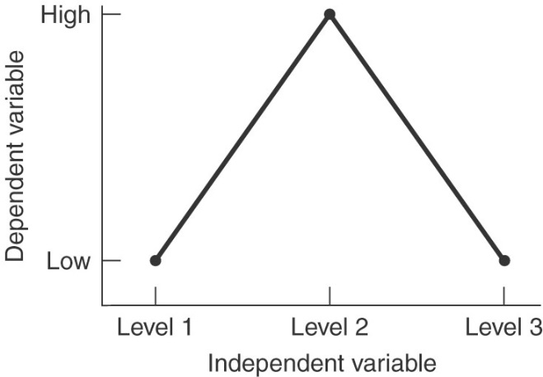
Increasing the # of Levels of an IV
Provides more information about the relationship than a two-level design
Can reveal a curvilinear relationship
Allows us to compare more than two groups

Slide 6
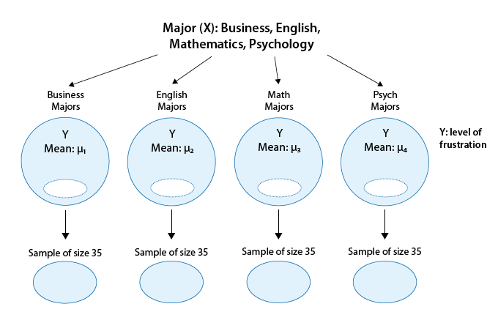
Is “academic frustration” related to major?
4 groups!

Slide 7
Which statistical test(s) to run?
Independent Variable | Dependent Variable
 |  | Continuous | Categorical
 | Continuous | correlation regression | logistic regression
 | Categorical | z-Test t-Test ANOVA | chi-square binomial test

Slide 8
Analysis of Variance (ANOVA)
Tests claims about mean differences between two or more populations by using two or more samples
The tested hypothesis is very similar to the t-statistic, but now can be applied when we have more than two groups

Slide 9
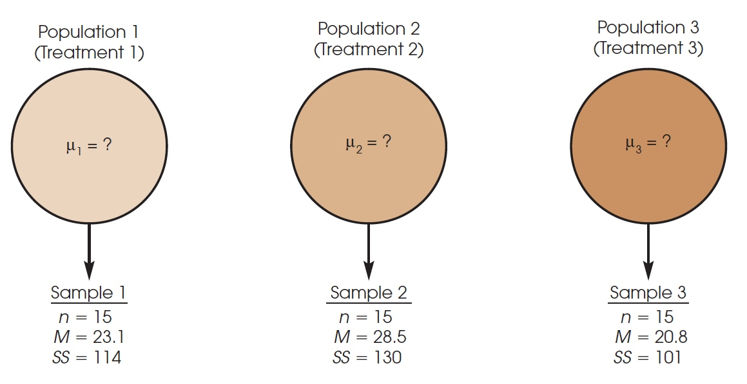
A Typical Example of a Situation Requiring ANOVA
t-tests only allow the comparison of 2 means at a time
This would require 3 separate t-tests with 3 separate 𝛼-levels, which accumulate over a series of tests (increasing chances of type I error)
ANOVA allows the evaluation of all three means at once

Slide 10
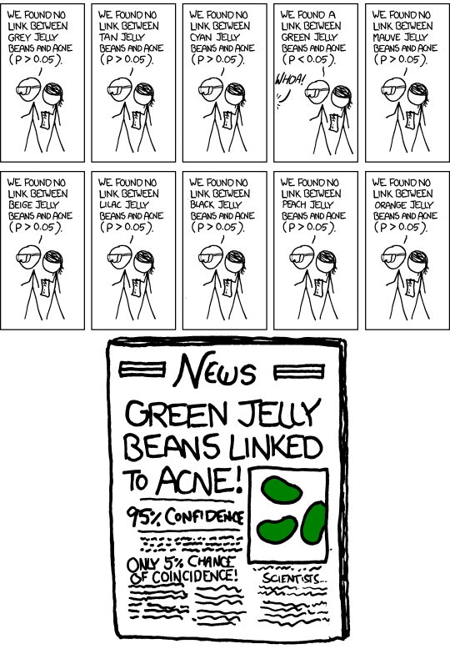
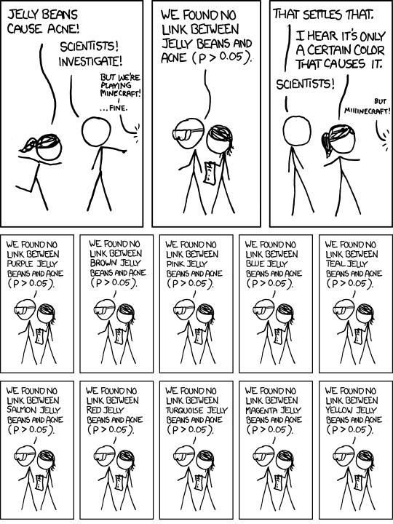

Slide 11
Terminology in ANOVA
Independent Variable: Telephone conditions
No phone
Hands-free
Hand-held
Three treatment conditions are created by the researcher
Quasi-Independent Variable: Age
Teenagers
Adults
Non-manipulated variable used to create groups
Elderly
The variable that designates the groups being compared is called a factor (e.g., “telephone condition,” “age”)
The individual conditions or values that make up a factor are called levels of the factor (e.g., 3 telephone conditions, 3 age groups)

Slide 12

Statistical Hypotheses for ANOVA
Telephone conditions
No phone
Hands-free
Hand-held
The Null Hypothesis
All populations have the same mean (there is no mean difference between any of the groups)
Telephone condition has no effect on driving performance

Slide 13
Statistical Hypotheses for ANOVA
Telephone conditions
No phone
Hands-free
Hand-held
The Alternative Hypothesis
There is at least one mean difference among populations
At least one of the population means is different from another (no specific decision which or how they differ)
Not all treatment conditions are the same, there is a treatment effect somewhere

Slide 14
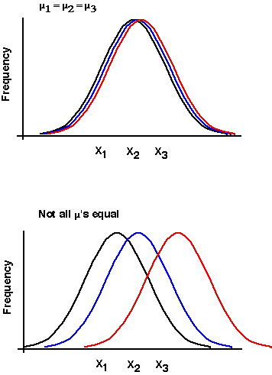
The Null Hypothesis
The Alternative Hypothesis
There is at least one mean difference among populations

Slide 15
Why Variance vs. Mean Differences?
When we have more than two sample means, how do you evaluate a mean difference?
It’s problematic!
However, we can evaluate the variance between these three means:

Slide 16
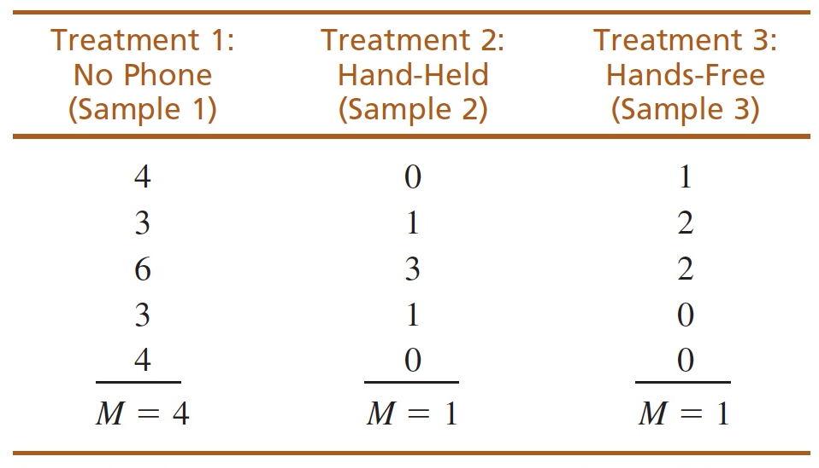
The Logic of ANOVA
These scores are all different. Or, in statistical terms, these scores are all variable.
Our goal is to measure the amount of variability to explain why the scores are different
Three steps:
Calculate between-groups variance
Here we see that there is large variance between sample means
Calculate within-groups variance
There is some variability in scores within each sample
Calculate the F-ratio to compare the two variances, and compare to a critical value

Slide 17
ANOVA: The F-test
A ratio of two measures of variability:
Between groups variance (MS_{b})
Within groups variance (MS_{w})
F =
Between groups variance: an estimate of the population variance based on differences among the means of your different groups/conditions
Within groups variance: an estimate of the population variance based on the differences within each of the sample (condition) distributions

Slide 18
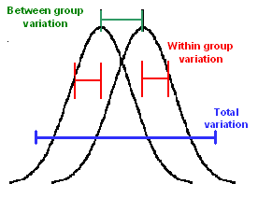

Slide 19
ANOVA: The F-test
Between-Groups Variance
Within-Groups Variance
How do participants in different conditions differ?
This is the variance we are typically interested in because higher indicates more differences between samples/groups
Possible sources of variance:
Differences caused by treatment (IV)
Random chance
How do participants within the same condition differ?
Variance due to chance and sampling error (“Noise”)
How big are the differences between individuals when there is no treatment effect?

Slide 20
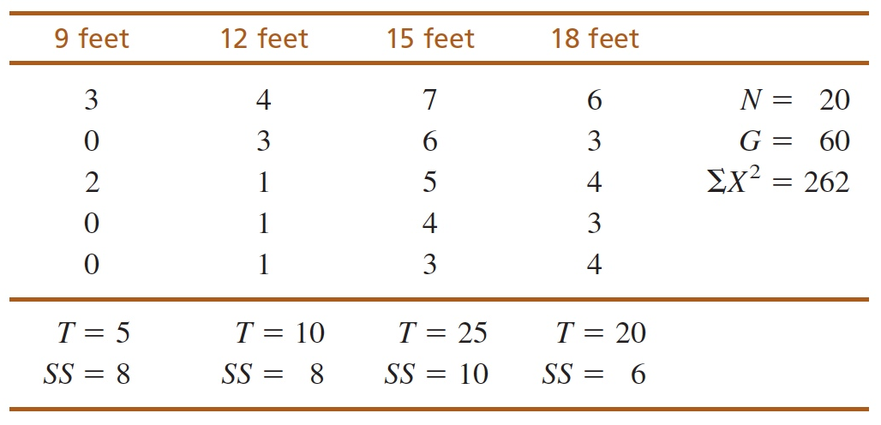
Are there any differences in satisfaction with different viewing distances of a 42-inch HDTV?

Slide 21
State your hypotheses and set alpha
There is no effect of viewing distances on ratings of satisfaction of watching HDTV
There is an effect of viewing distances on ratings of satisfaction of watching HDTV

Slide 22
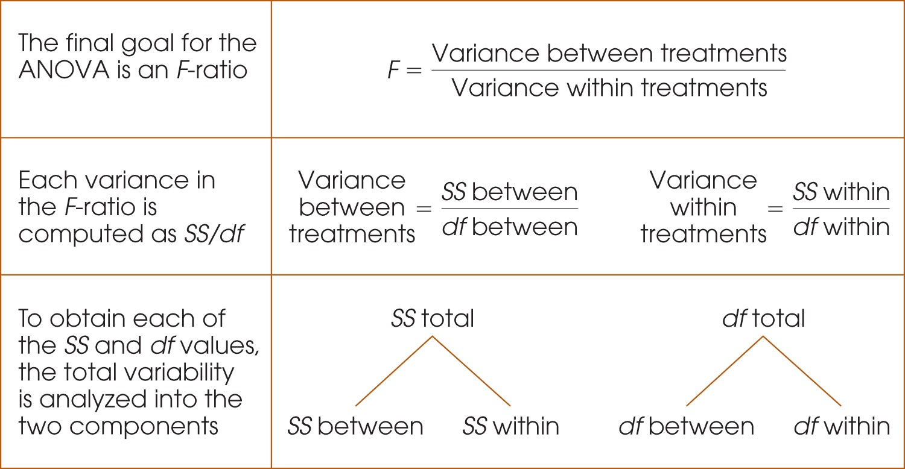
Steps in ANOVA

Slide 23
Make a Decision Regarding H₀
Our Critical F (F_{crit})
Our Computed F
Our F statistic falls in the critical region:
Our computed F (8.33) has a larger value than our critical F (3.24)
Therefore, reject the null hypothesis
It is very unlikely (p < .05) that we would obtain a value this large if H₀ is true. Therefore we reject the null hypothesis and conclude that there is a significant effect of viewing distance on pleasure in HDTV

Slide 24
ANOVA for different designs
One-way ANOVA: Tests differences in means when you have one categorical, between-subjects IV with at least 2 levels
Repeated Measures ANOVA: Used when your categorical IV is manipulated within-subjects
Two-way (factorial) ANOVA: Used when you have multiple IVs, each with 2 or more levels

Slide 25
ANOVAs for different designs
One-way ANOVA: Tests differences in means when you have one categorical, between-subjects IV with at least 2 levels
Repeated Measures ANOVA: Used when your categorical IV is manipulated within-subjects
Two-way (factorial) ANOVA: Used when you have multiple IVs, each with 2 or more levels (can include both between and within-subjects variables!).

Slide 26
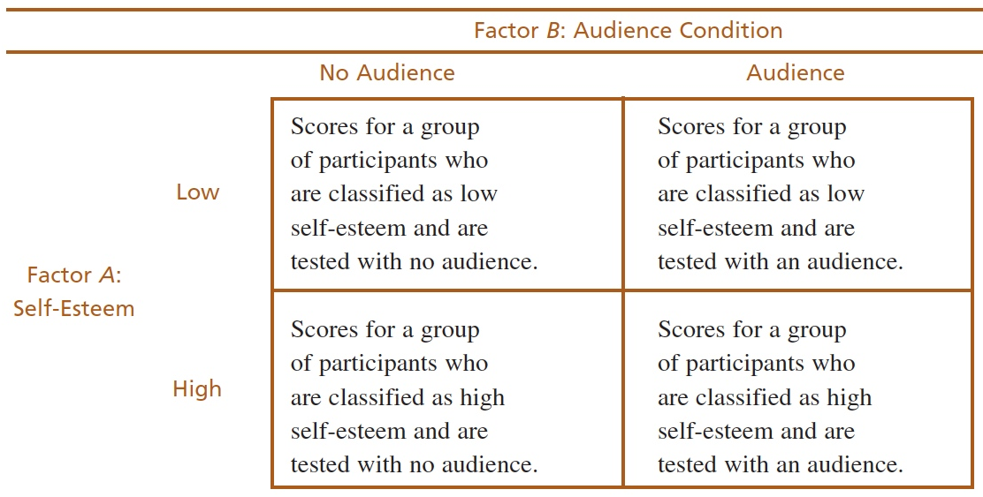
Research designs with two-factors
Two IVs, each with their own levels
Creates a research design which allows us to look at every possible condition
Summarized in a matrix, where we would require a separate sample for each cell

Slide 27
A Two-Factor Research Study
A researcher studying the effects of heat and humidity on performance could use the following experimental design:
 | B₁ 80-degree room | B₂ 90-degree room | B₃ 100-degree room
A₁ Low Humidity | Sample 1 Low humidity 80-degree room | Sample 2 Low humidity 90-degree room | Sample 3 Low humidity 100-degree room
A₂ High Humidity | Sample 4 High humidity 80-degree room | Sample 5 High humidity 90-degree room | Sample 6 high humidity 100-degree room

Slide 28
This is an example of a 2 x 2 ANOVA
 | B₁ Drug A | B₂ Drug B
A₁ Males | Sample 1 | Sample 2
A₂ Females | Sample 3 | Sample 4
This is an example of a 2 x 3 ANOVA
 | B₁ 80-degree room | B₂ 90-degree room | B₃ 100-degree room
A₁ Low Humidity | Sample 1 | Sample 2 | Sample 3
A₂ High Humidity | Sample 4 | Sample 5 | Sample 6

Slide 29
What does the factorial ANOVA do?
Evaluates three separate sets of mean differences:
Mean difference between the two humidity levels
Mean differences between the three temperature levels
Interactions between humidity and temp: Any other mean differences that may result from unique combinations of a specific humidity level and a specific temperature level.
 | B₁ 80-degree room | B₂ 90-degree room | B₃ 100-degree room
A₁ Low Humidity | Sample 1 | Sample 2 | Sample 3
A₂ High Humidity | Sample 4 | Sample 5 | Sample 6

Slide 30
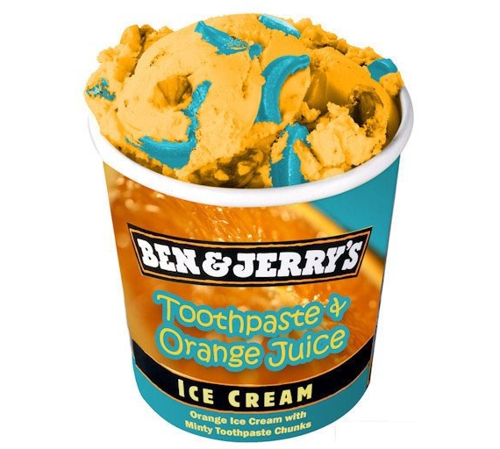
Main effects and interactions

Slide 31
Interpretation of Factorial Designs
 | B₁ Drug A | B₂ Drug B
A₁ Males | Sample 1 | Sample 2
A₂ Females | Sample 3 | Sample 4
Main Effects
The effect of each independent variable taken by itself
There is a “main effect” test for each IV in your design
Interactions
Effect of one IV depends on the particular level of the other IV
There is only one interaction in a two-factor design

Slide 32
What means are we evaluating?
 | Drug A | Drug B
Males | M = 50 | M = 70
Females | M = 90 | M = 70
M_{Males} = 60
M_{Females} = 80
M_{DrugA} = 70
M_{DrugB} = 70
Main effect for Factor A (gender): Compares the means for males (60) and for females (80)
Main effect for Factor B (audience): Compares the means for Drug A (70) and Drug B (70)
Interaction (self-esteem x audience): Evaluates how the means for the levels for gender (Factor A) are influenced by drug (Factor B)

Slide 33
Why are interactions important?
 | Drug A | Drug B
Males | M = 50 | M = 70
Females | M = 90 | M = 70
M_{Males} = 60
M_{Females} = 80
M_{DrugA} = 70
M_{DrugB} = 70
If the DV is depression scores, what conclusions would you draw from just considering the main effects?
Now how does considering the interaction between drug and gender change your conclusions?

Slide 34

Measuring interactions
Variance (mean differences) not explained by main effects
variance (differences) expected by chance/error
If the two factors are independent (do not influence the effect of each other) there will be no interaction

Slide 35
Graphical Illustrations of an Interaction

Slide 36
Non-parallel lines are the telltale sign of an interaction!
36
1
2
3
4
5
6
7
8
9

Slide 37
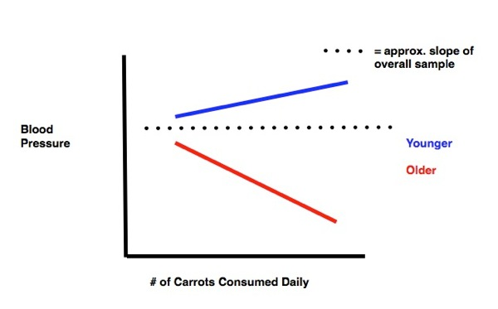
Interactions and Moderator Variables
A moderator variable is any variable that influences the relationship between two other variables:
Last example: gender as a moderator between drug and depression scores
Influence of carrot consumption on the relationship between age and blood pressure

Slide 38
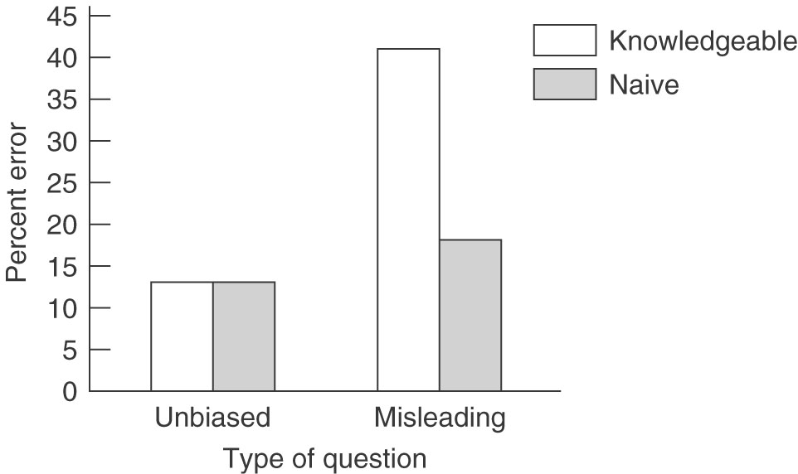
Interactions and Moderator Variables
Research hypothesis:
Misleading questions result in more errors in eyewitness testimony than do unbiased questions
Misleading questions result in more errors only when the questioner is believed to be knowledgeable; no increase in errors will occur when the questioner is naive

Slide 39
When there is no interaction:
Here, there may be main effects for gender and for drug, but no interaction between these two variables

Slide 40
Some additional experimental design possibilities:

Slide 41
Cross-Sectional Design
People of different age groups measured at the same point in time (multiple cohorts)
Cohort: A group of people of the same age at the same point in history
 | Year of Birth (cohort) | Time 1: 2005
Group 1 | 1950 | 55 years old
Group 2 | 1945 | 60 years old
Group 3 | 1940 | 65 years old

Slide 42
Cross-Sectional Design
Advantages
Relatively quick
Relatively inexpensive
Gives insight into normative developmental change
Disadvantages
Cohort Effects: experiences that happen at a certain point in time can cause an age group at one point in history to differ from the same age group at a different point in history
Does not provide information about individual differences

Slide 43
Longitudinal Design
Same group (one cohort) is followed over time
 | Year of Birth (cohort) | Time 1: 2005 | Time 2: 2010 | Time 3: 2015
Group 1: | 1950 | 55 yr → | 60 yr → | 65 yr

Slide 44
Longitudinal Design
Advantages
Limits unimportant variability
Gives insight into the role of the individual in behavior
Gives insight into the cumulative effect of experiences over time
Gives insight into normative developmental change
Disadvantages
Time consuming
Expensive
Selective attrition: may lose more individuals of a certain type
Cannot assess cohort effects

Slide 45
Cross-Sequential Design
Multiple cohorts are studied over time
 | Year of Birth (cohort) | Time 1: 2005 | Time 2: 2010 | Time 3: 2015
Group 1: | 1950 | 55 yr → | 60 yr → | 65 yr
Group 2: | 1940 | 65 yr → | 70 yr → | 75 yr

Slide 46
Cross-Sequential Design
Combines the advantages of both cross-sectional and longitudinal designs:
Gives insight into the role of the individual in behavior (e.g. genes express themselves more actively with time)
Gives insight into the cumulative effect of experience over time (e.g. experiences in childhood can influence behaviors later in life more dramatically than they influence immediate behaviors)
Gives insight into normative developmental change
Get initial data quickly and cheaply
Can analyze data to look for selective attrition

Slide 47
What kind of DV do I have?
Continuous
Categorical
What kind of IV do I have?
Continuous
Categorical
Continuous
Categorical
How many IVs do I have?
Logistic Regression
One
> One
One
> One
Multiple regression
One
Two
correlation
χ² goodness of fit
How many levels in my IV?
Two
> Two
χ² test of independence
What kind of design?
Within Subs
Between Subs
Within Subs
Between Subs
Paired-samples t-test
Independent-samples t-test
Repeated Measures ANOVA
ANOVA

Slide 48
Running and Writing up ANOVAs with one IV (with 3 or more levels)

Slide 49
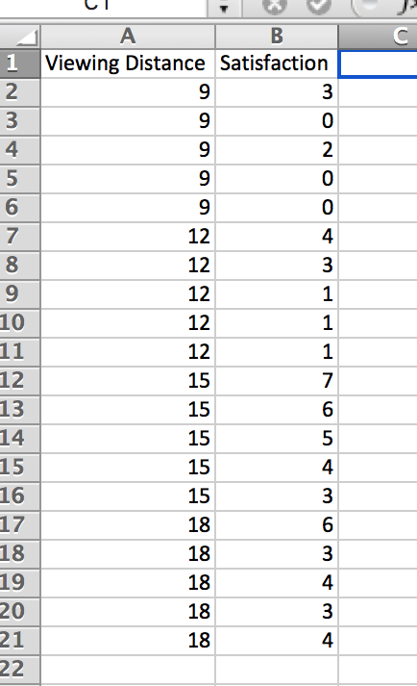

Slide 50
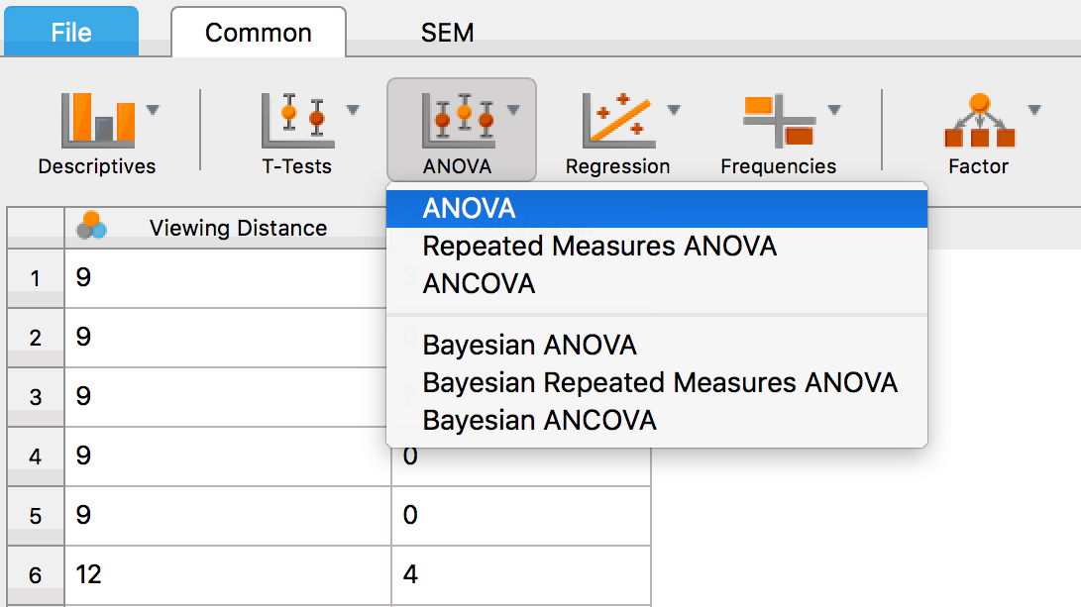

Slide 51
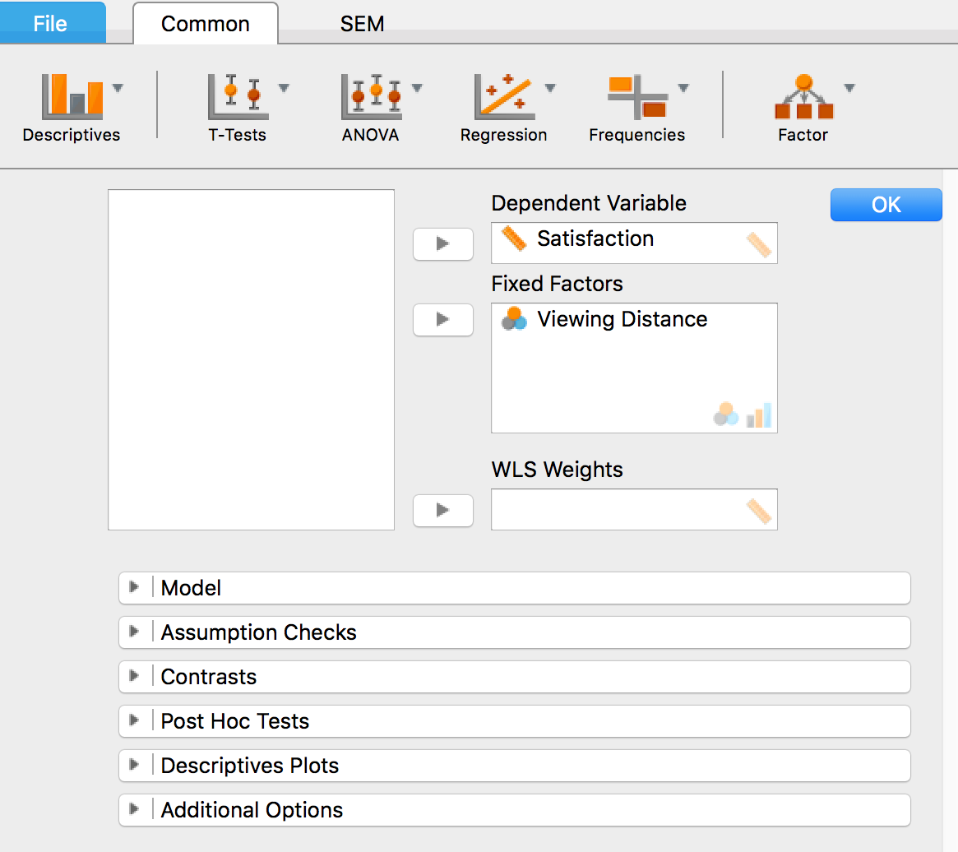

Slide 52
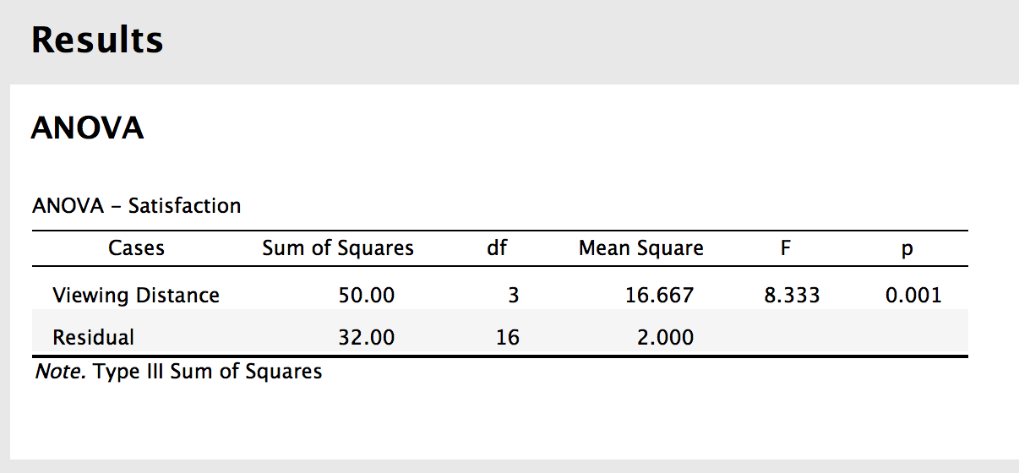

Slide 53
Post Hoc Tests
When we reject the null hypothesis in ANOVA, we know there is a significant difference somewhere between at least two of the groups (not all groups are equal). But we don’t know where the difference is. If we have 3 groups (A, B, C):
Group A could be different than B
or group B from C
or group A from C
Or all/some of these!
So, if the results of our F-test is statistically significant (p < 0.05), more tests must be done to find which groups are different from one another

Slide 54
Post Hoc Tests
Post Hoc Tests: Additional statistical tests that are done after finding a significant F-value to determine exactly which groups are significantly different from one another
Developed to control for increases in Type I error associated with running multiple statistical tests
Popular Post Hoc tests:
Tukey’s Honestly Significant Difference (HSD)
Scheffé Test
Bonferroni Test

Slide 55
Effect Size for ANOVA
A statistically significant effect indicates the difference between groups is unlikely to be the case if H₀ is true, but does not tell us how large this difference is
= the % of variance accounted for
0.01 = small sized effect
Rule of thumb: 0.06 = medium sized effect
0.14 = large sized effect

Slide 59
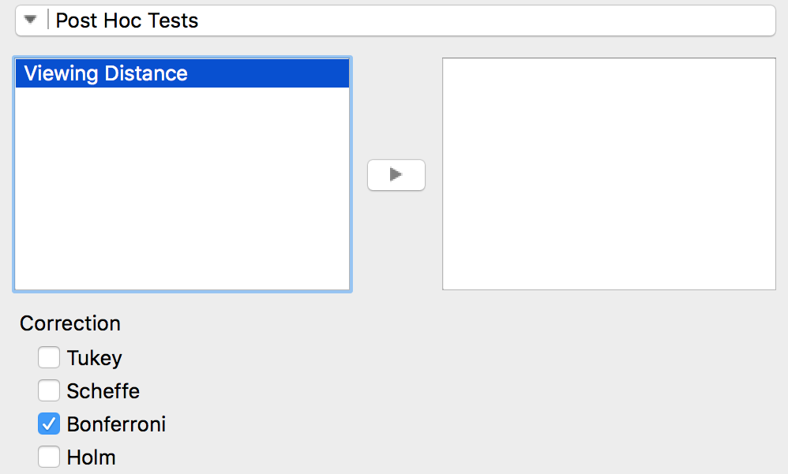
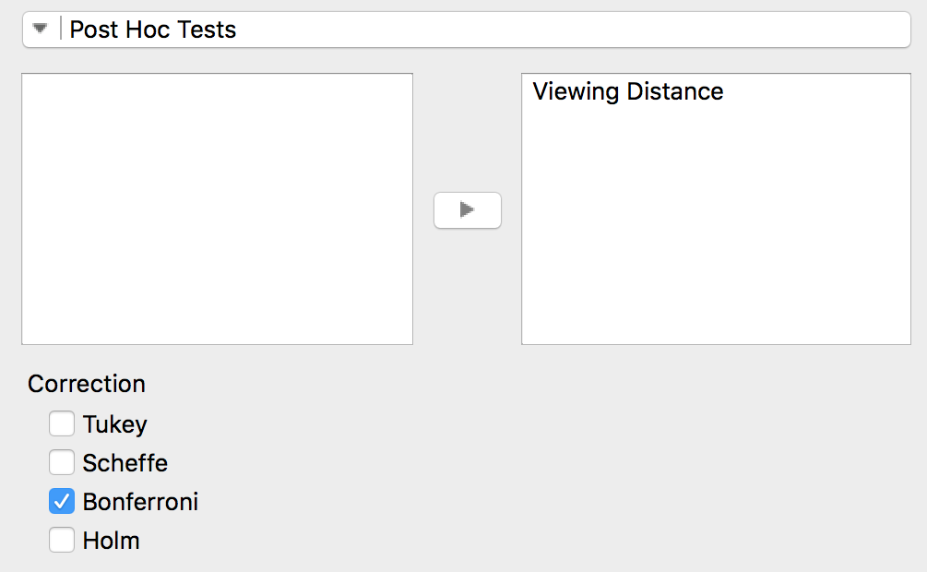

Slide 60
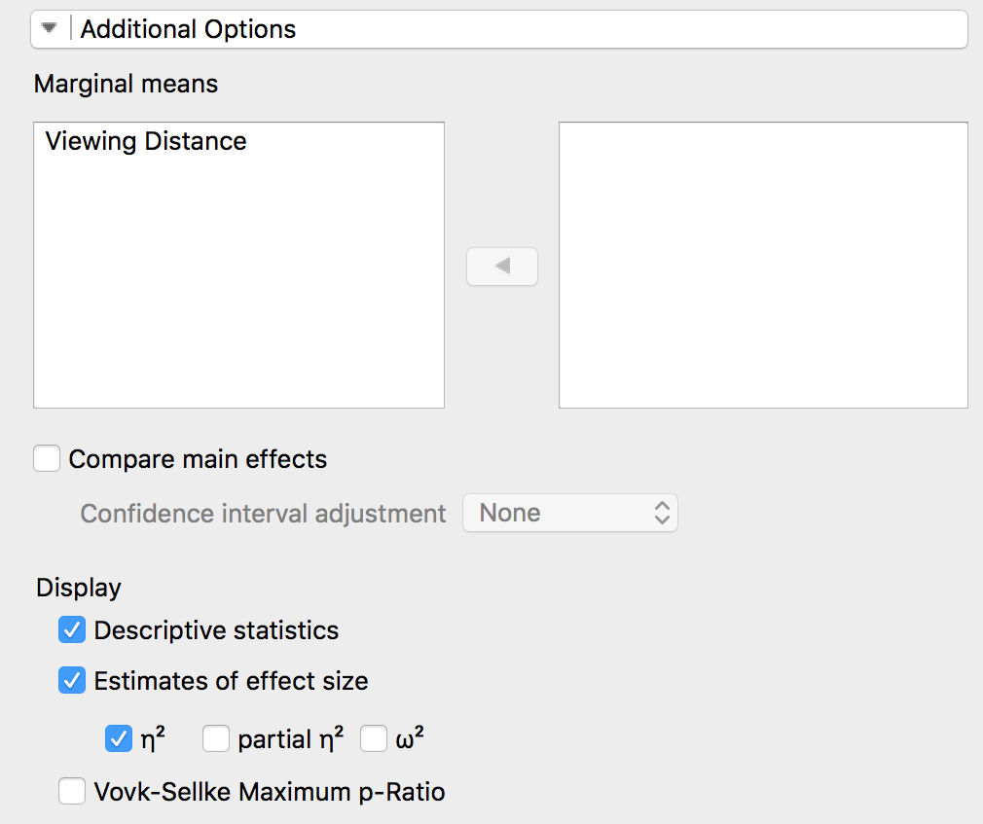

Slide 61
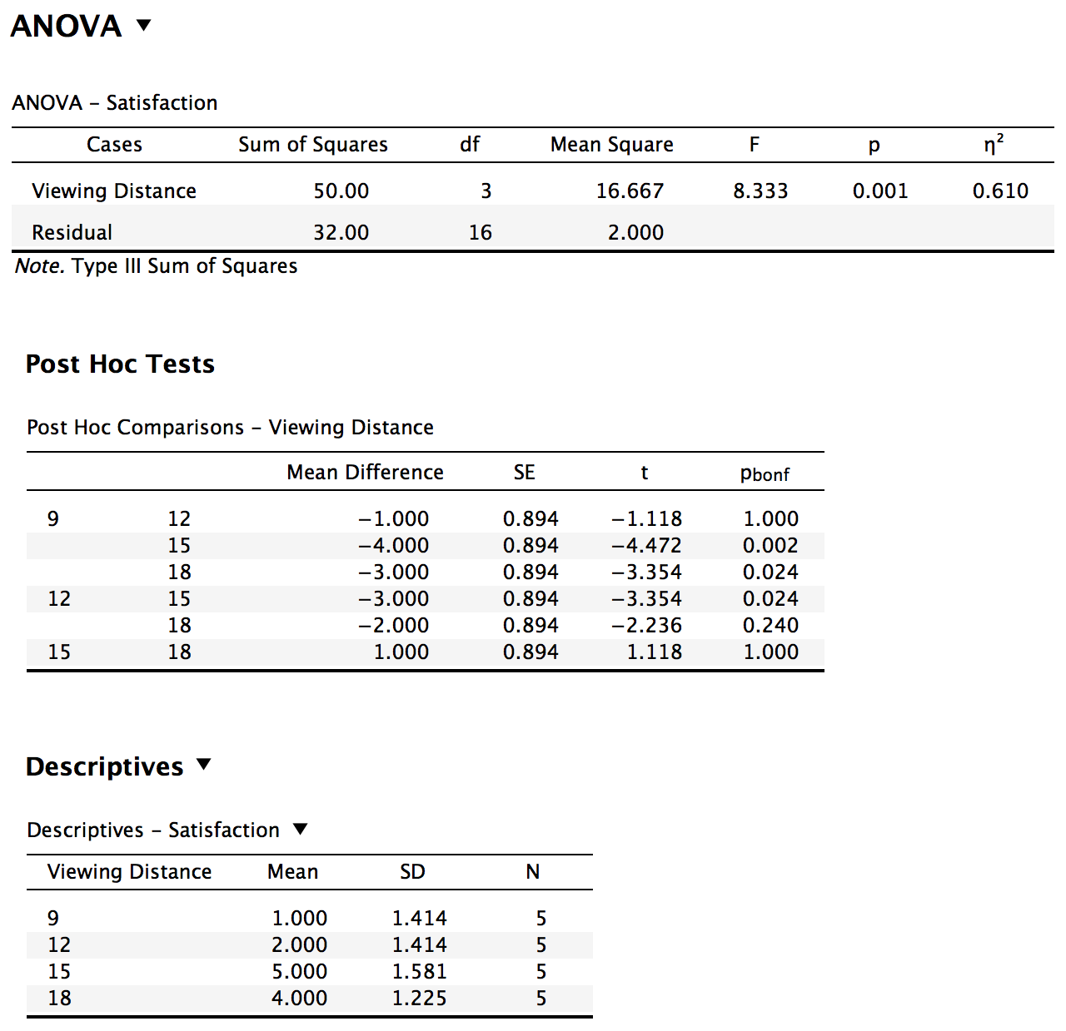

Slide 62
Writing up the Analysis
A one-way ANOVA revealed that there was a statistically significant effect of viewing distance on how satisfied people were with watching a 42 inch high definition television, F(3, 16) = 8.33, p = 0.001, η² = 0.61. A series of post hoc tests using the Bonferroni correction were conducted to determine which viewing distances were significantly different from one another. This analysis revealed that people expressed significantly less satisfaction viewing the TV from 9 feet (M = 1, SD = 1.41), compared to 15 feet (M = 5, SD = 1.58) and 18 feet (M = 4, SD = 1.23), p = 0.002 and 0.024, respectively. People also expressed less satisfaction watching the TV from 12 feet (M = 2, SD = 1.41) compared to 15 feet, p = 0.024. None of the other pairwise comparisons was statistically significant.

Slide 63
Plotting the Data

Slide 64
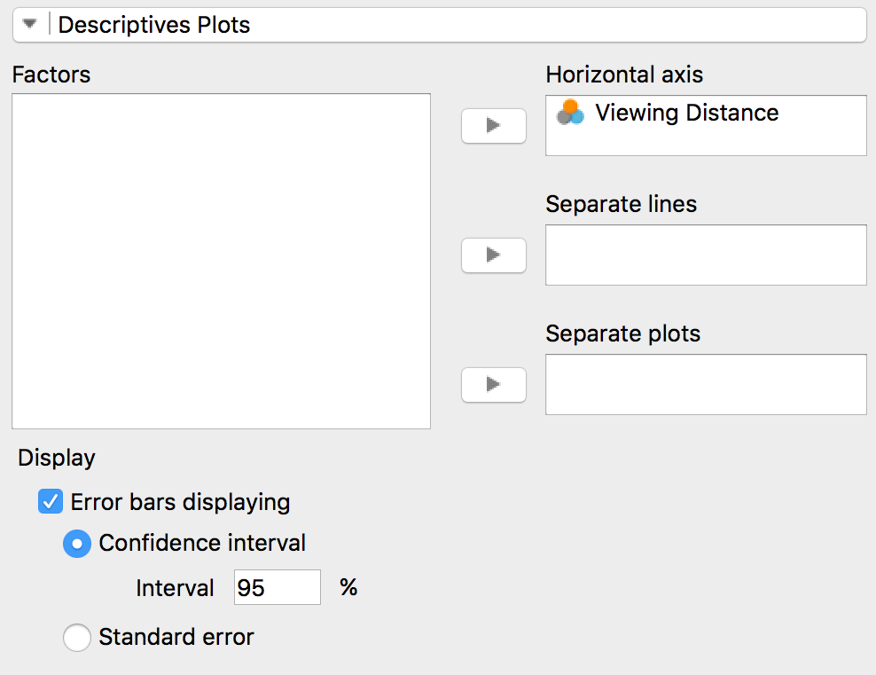
Plotting the Data

Slide 65
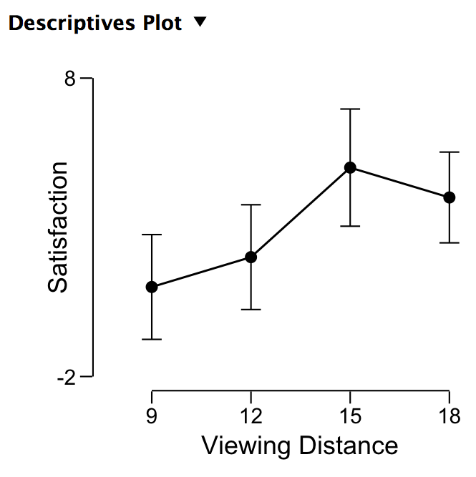
Plotting the Data

Slide 66
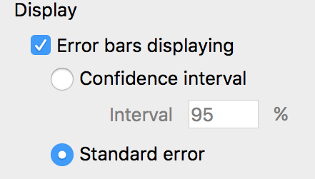
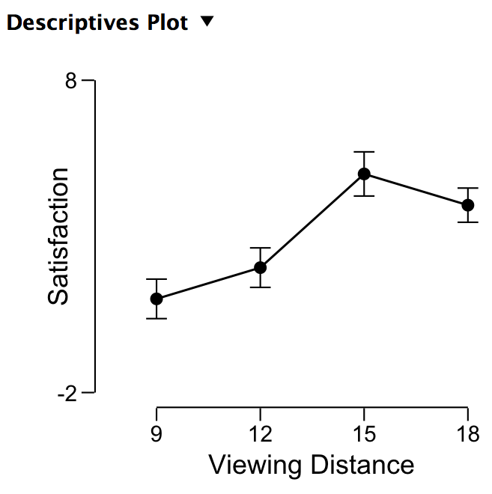
Plotting the Data

Slide 67
Plotting the Data
Error Bars = 95% Confidence Intervals
Error Bars = 1 Standard Error of the Mean

Slide 68
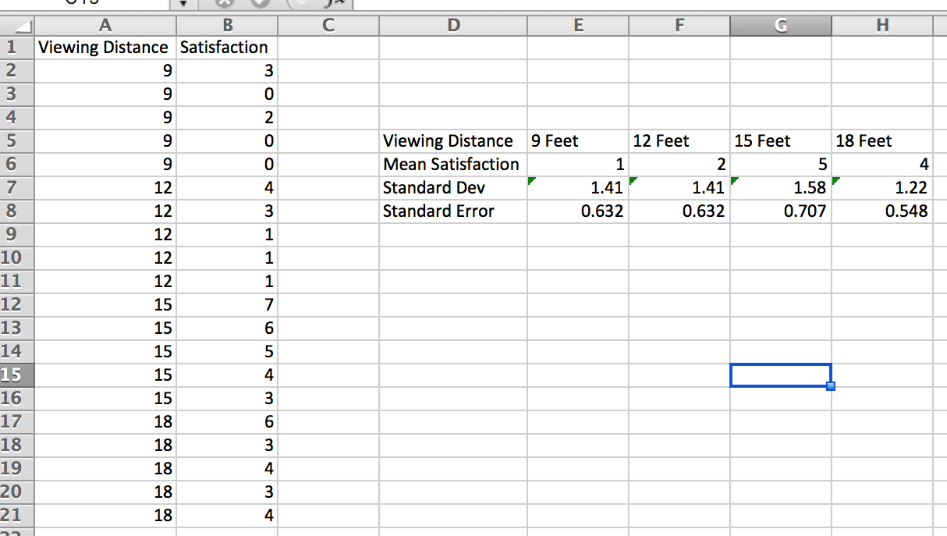
Plotting the Data

Slide 69
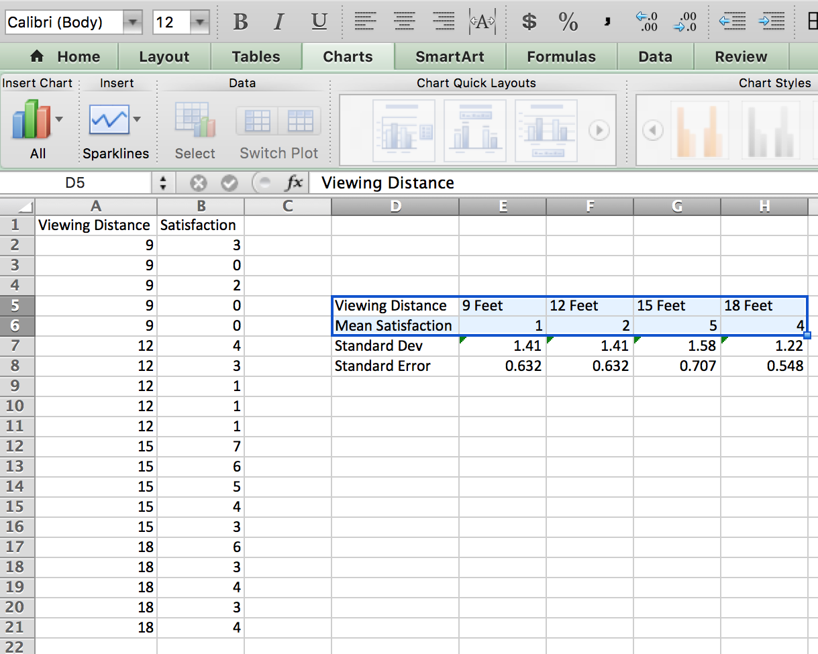
Plotting the Data

Slide 70
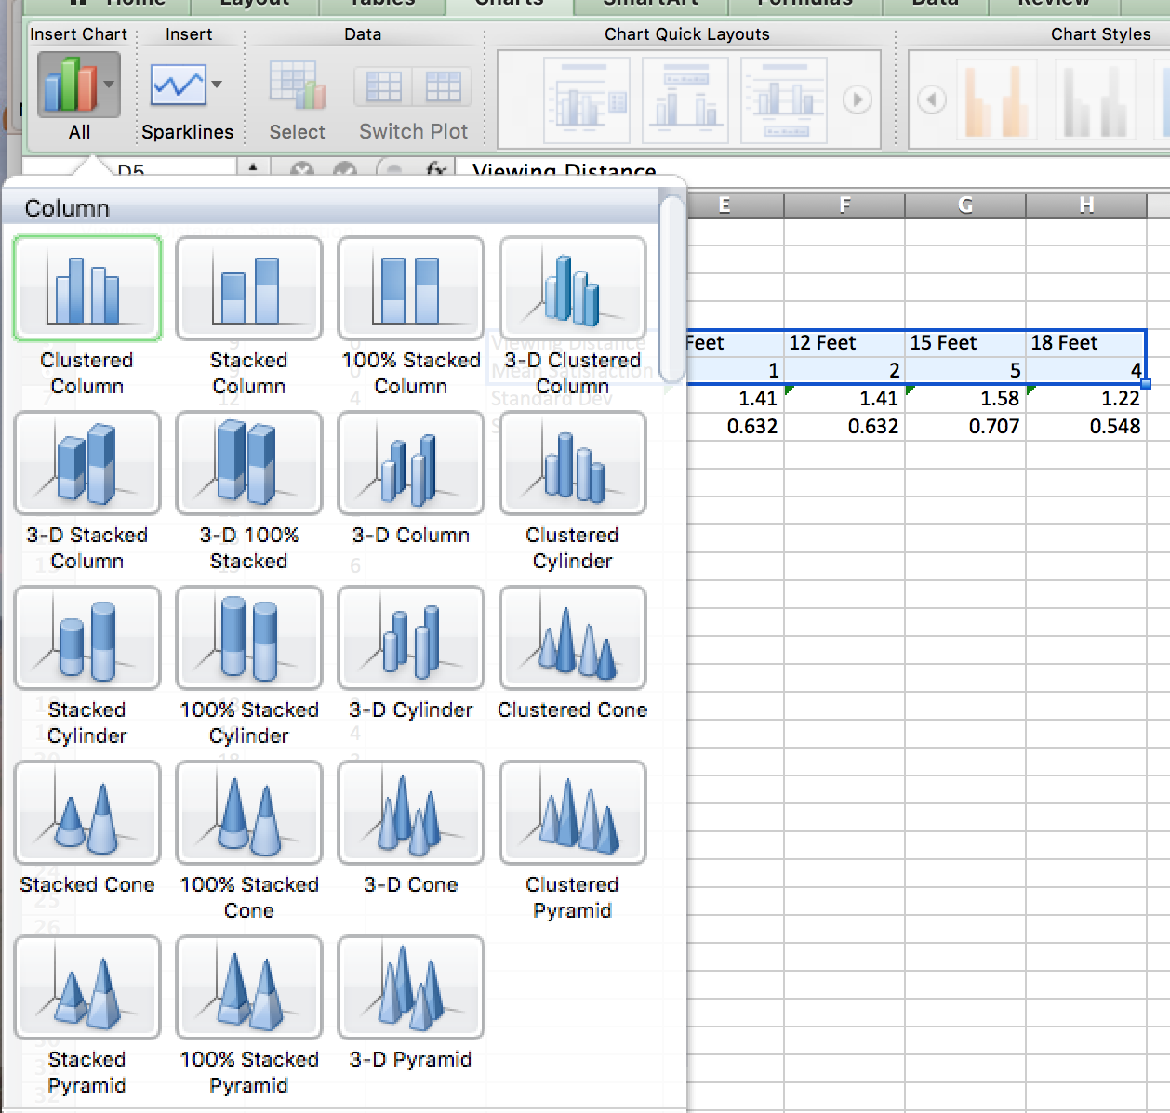
Plotting the Data

Slide 71
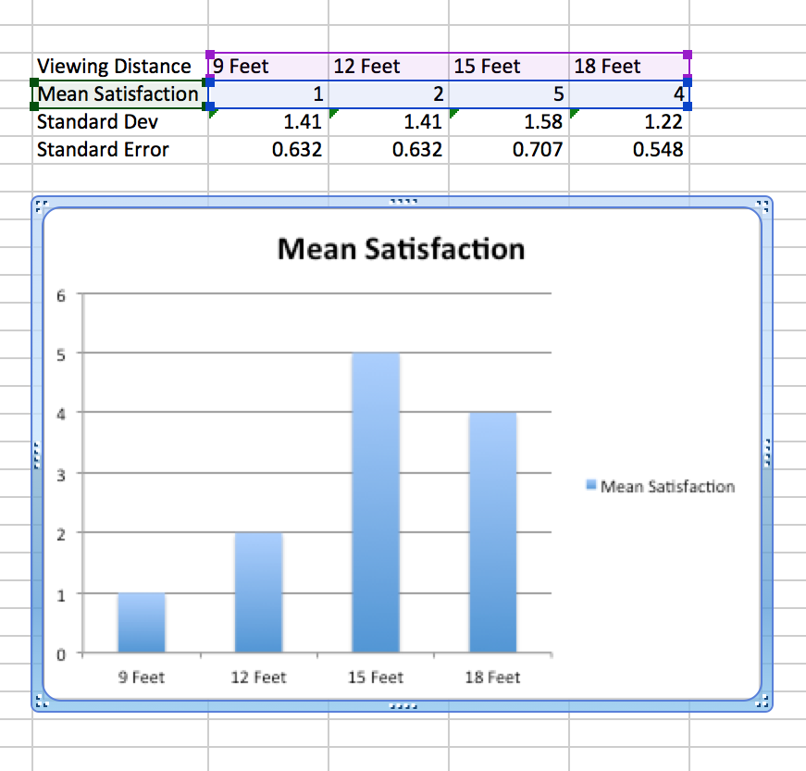
Plotting the Data

Slide 72
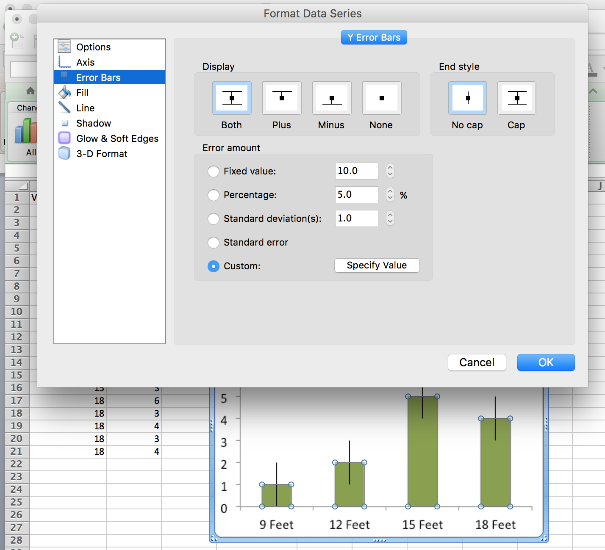
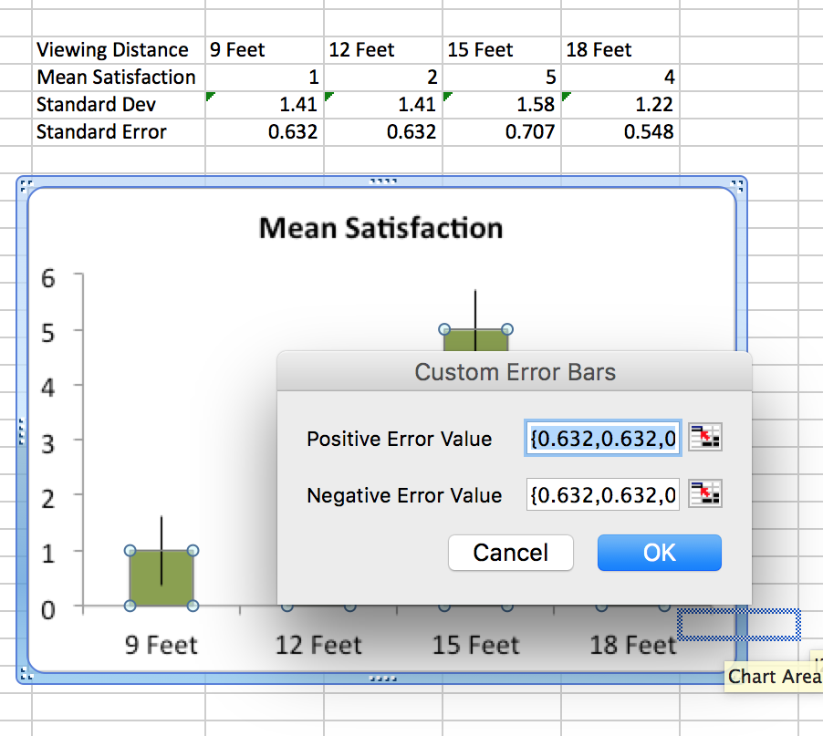
Plotting the Data

Slide 73
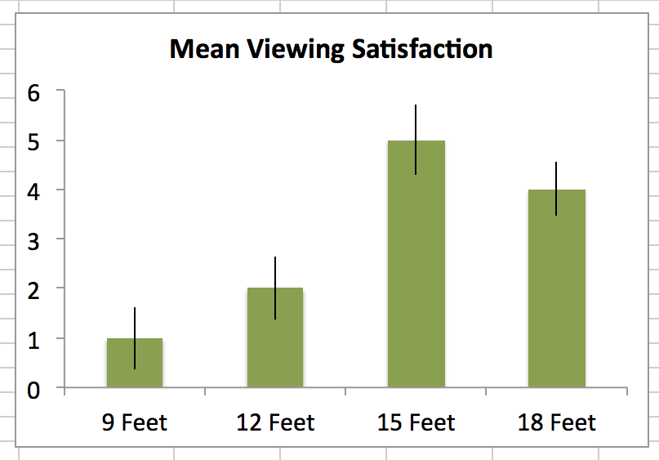
Plotting the Data

Slide 74
Running & Writing up anovas with more than one IV

Slide 75
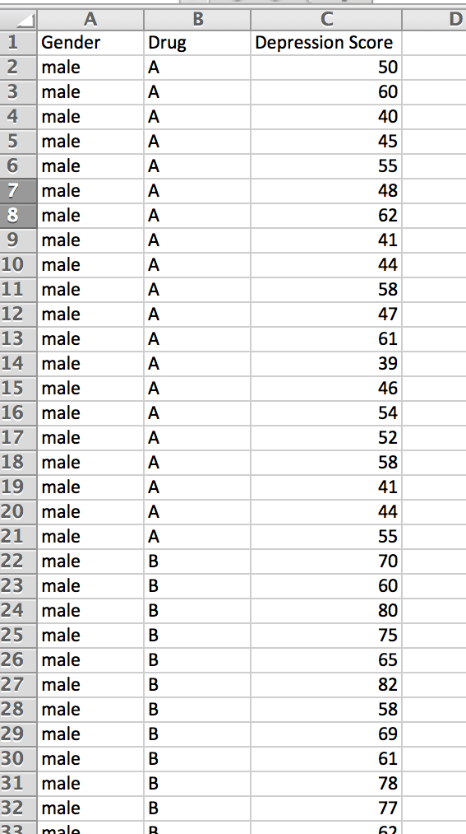
 | Drug A | Drug B
Males | M = 50 | M = 70
Females | M = 90 | M = 70

Slide 76
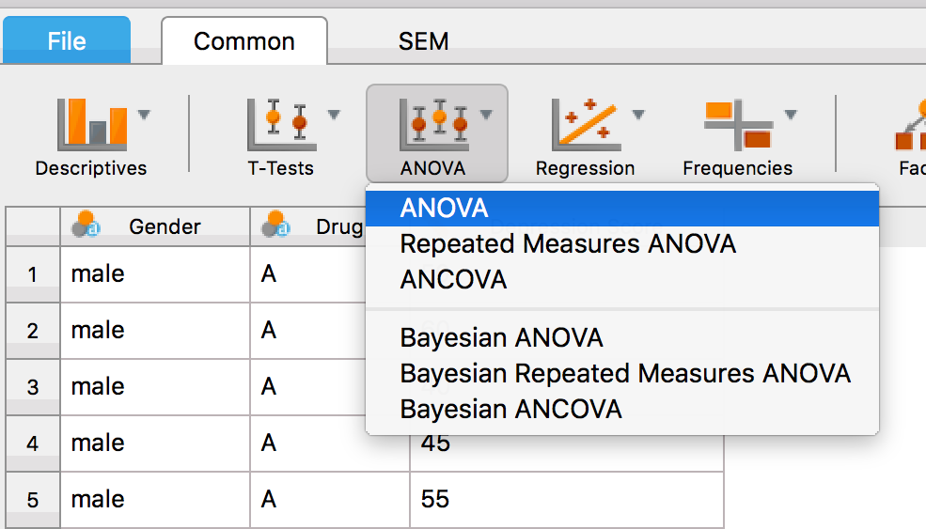
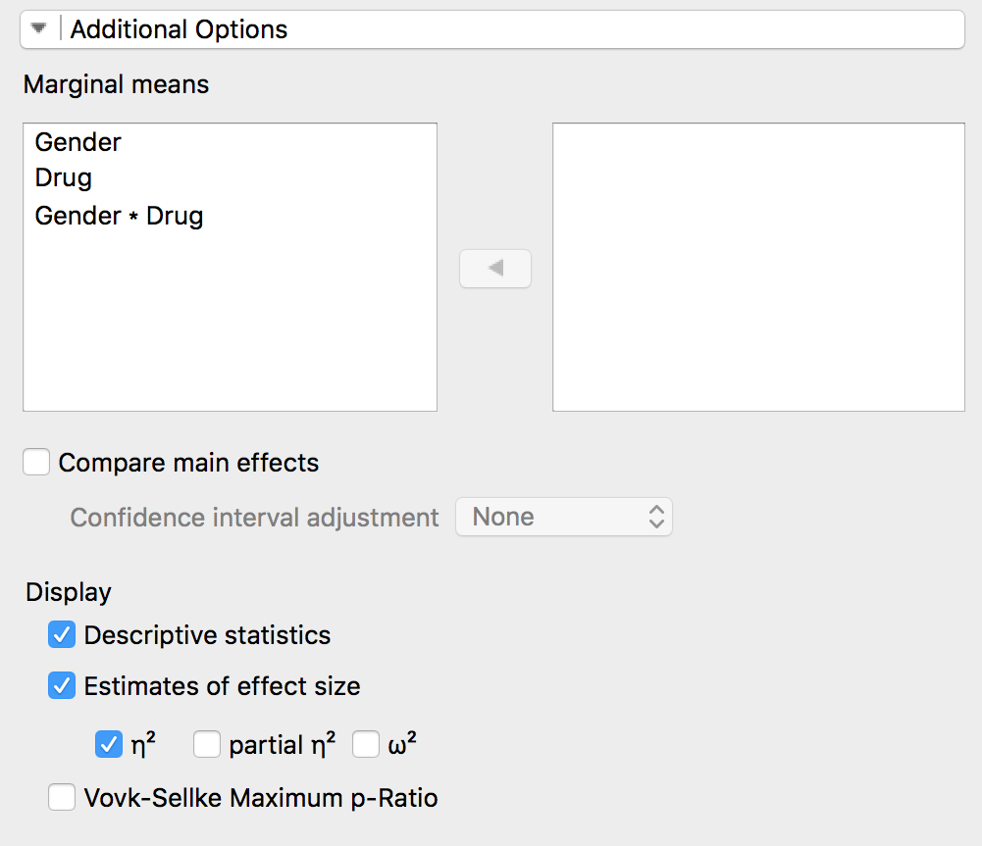
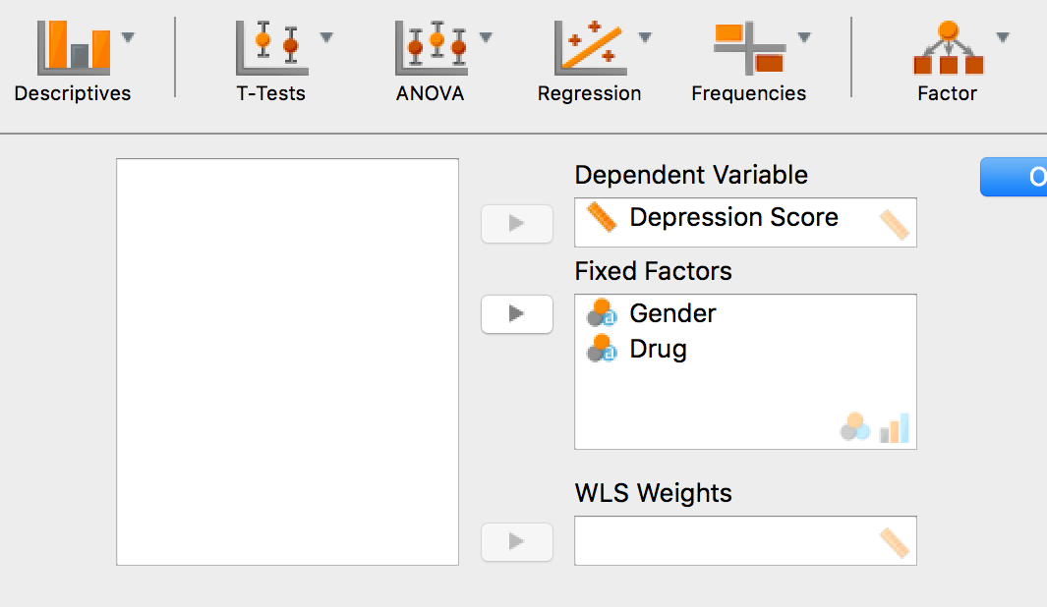

Slide 77
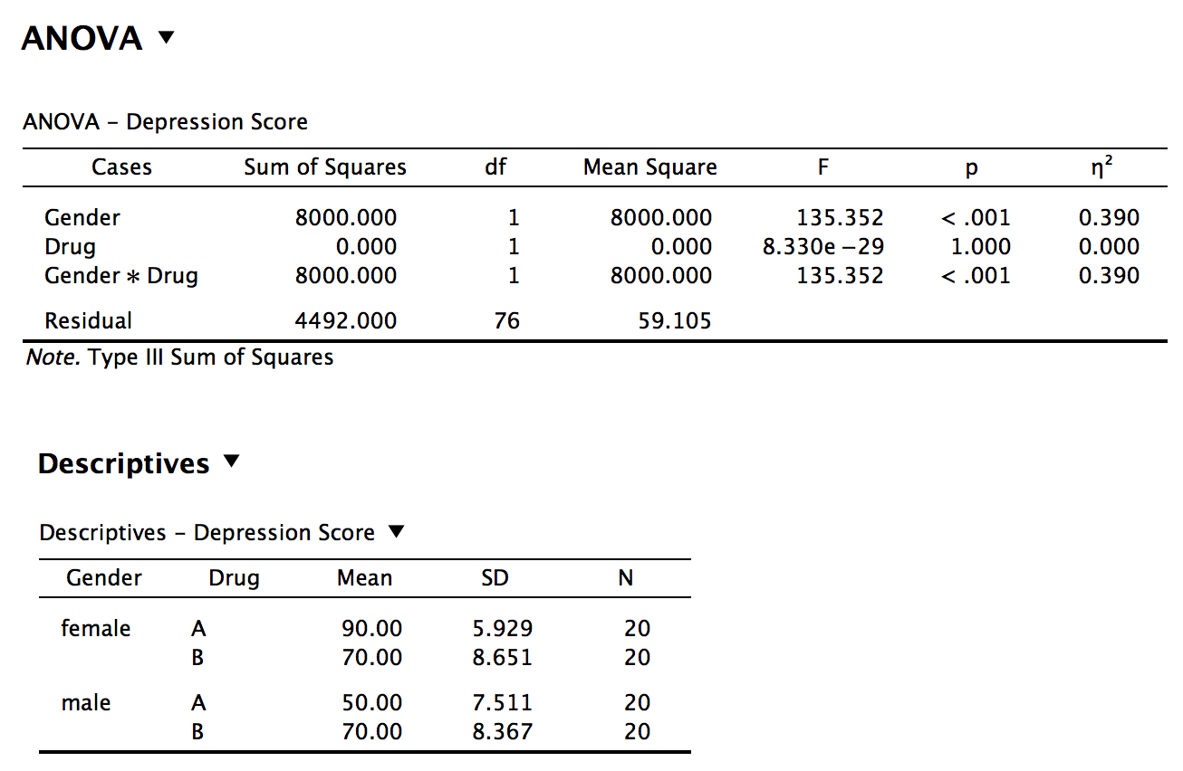

Slide 78
Writing up the Analysis
We conducted a 2 (Drug Type: A vs. B) X 2 (Gender: Male vs. Female) factorial ANOVA with depression scores as our dependent variable. There was a significant main effect of gender, as males (M = 60, SD = 12.81) had significantly lower depression scores than females (M = 80, SD = 12.50), F(1, 76) = 135.35, p < 0.001, η² = 0.39. There was no main effect of drug type, as participants who took Drug A (M = 70, SD = 21.33) had similar depression scores as those who took Drug B (M = 70, SD = 8.40), F(1, 76) = 0, p = 1. However, there was a significant interaction between Drug and Gender, F(1, 76) = 135.35, p < 0.001, η² = 0.39. While males (M = 70, SD = 8.37) and females (M = 70, SD = 8.65) who took Drug B had similar depressions scores, females who took Drug A (M = 90, SD = 5.93) had higher depression scores than males who took Drug A (M = 50, SD = 7.51).

